Slide 1

Insights into the Video Game Industry: A Data-Driven Approach
Neal Labern
Julian Panditharatne
Rasadari Ranasinghe
Mahnaz Khosravi

Slide 2



Outline
Introduction
Data Collection
Data Analysis
Visual Summary
Conclusion

Slide 3



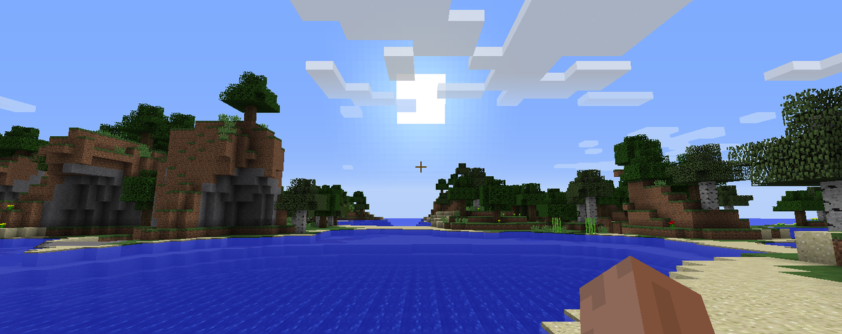
Introduction
Objective: To uncover patterns and insights in the early access games in video game industry
Data source: IGDB (Internet Game Database) API
Key areas of analysis:
Scores
Genres
Game modes
Release dates
Platforms
Regions
Developers
Publishers

Slide 4

Data COLLECTION
API Access and Data Retrieval:
Step 1:
Obtained access token from Twitch API using Client ID and Client Secret
Step 2:
Fetch game data calling the IGDB API
Step 3:
Extract relevant information and organize into dataframes
Step 4:
Cleaning data, modifying data and exporting the data frames as CSV files
Video games….

Slide 5

Data Processing
Data Processing:
Created multiple data frames focusing on different aspects like Game modes, genres, release dates, developers, publishers of early access games
Created various visualizations to uncover existing trends and patterns
Video games….

Slide 6

Data ANALYSIS
Key Areas of Analysis of Early Access Games:
Regional Trends in Games
Popularity of Genres and Game Modes
Seasonal and Platform-Specific Release Patterns
Impact of Developer Experience on Game Releases

Slide 7
Visual Summary
Game Scores Distribution:
Categorized games based on the regions
Highest regional distribution:
North America
Lowest regional distribution:
Korea
Video games….

Slide 8
Data ANALYSIS
Top rated Games Distribution:
Categorized games based on their average scores: Low, Medium, High, Very High
Highest regional distribution by highest-rated games:
North America
Lowest regional distribution by highest-rated games:
Europe
Video games….

Slide 9
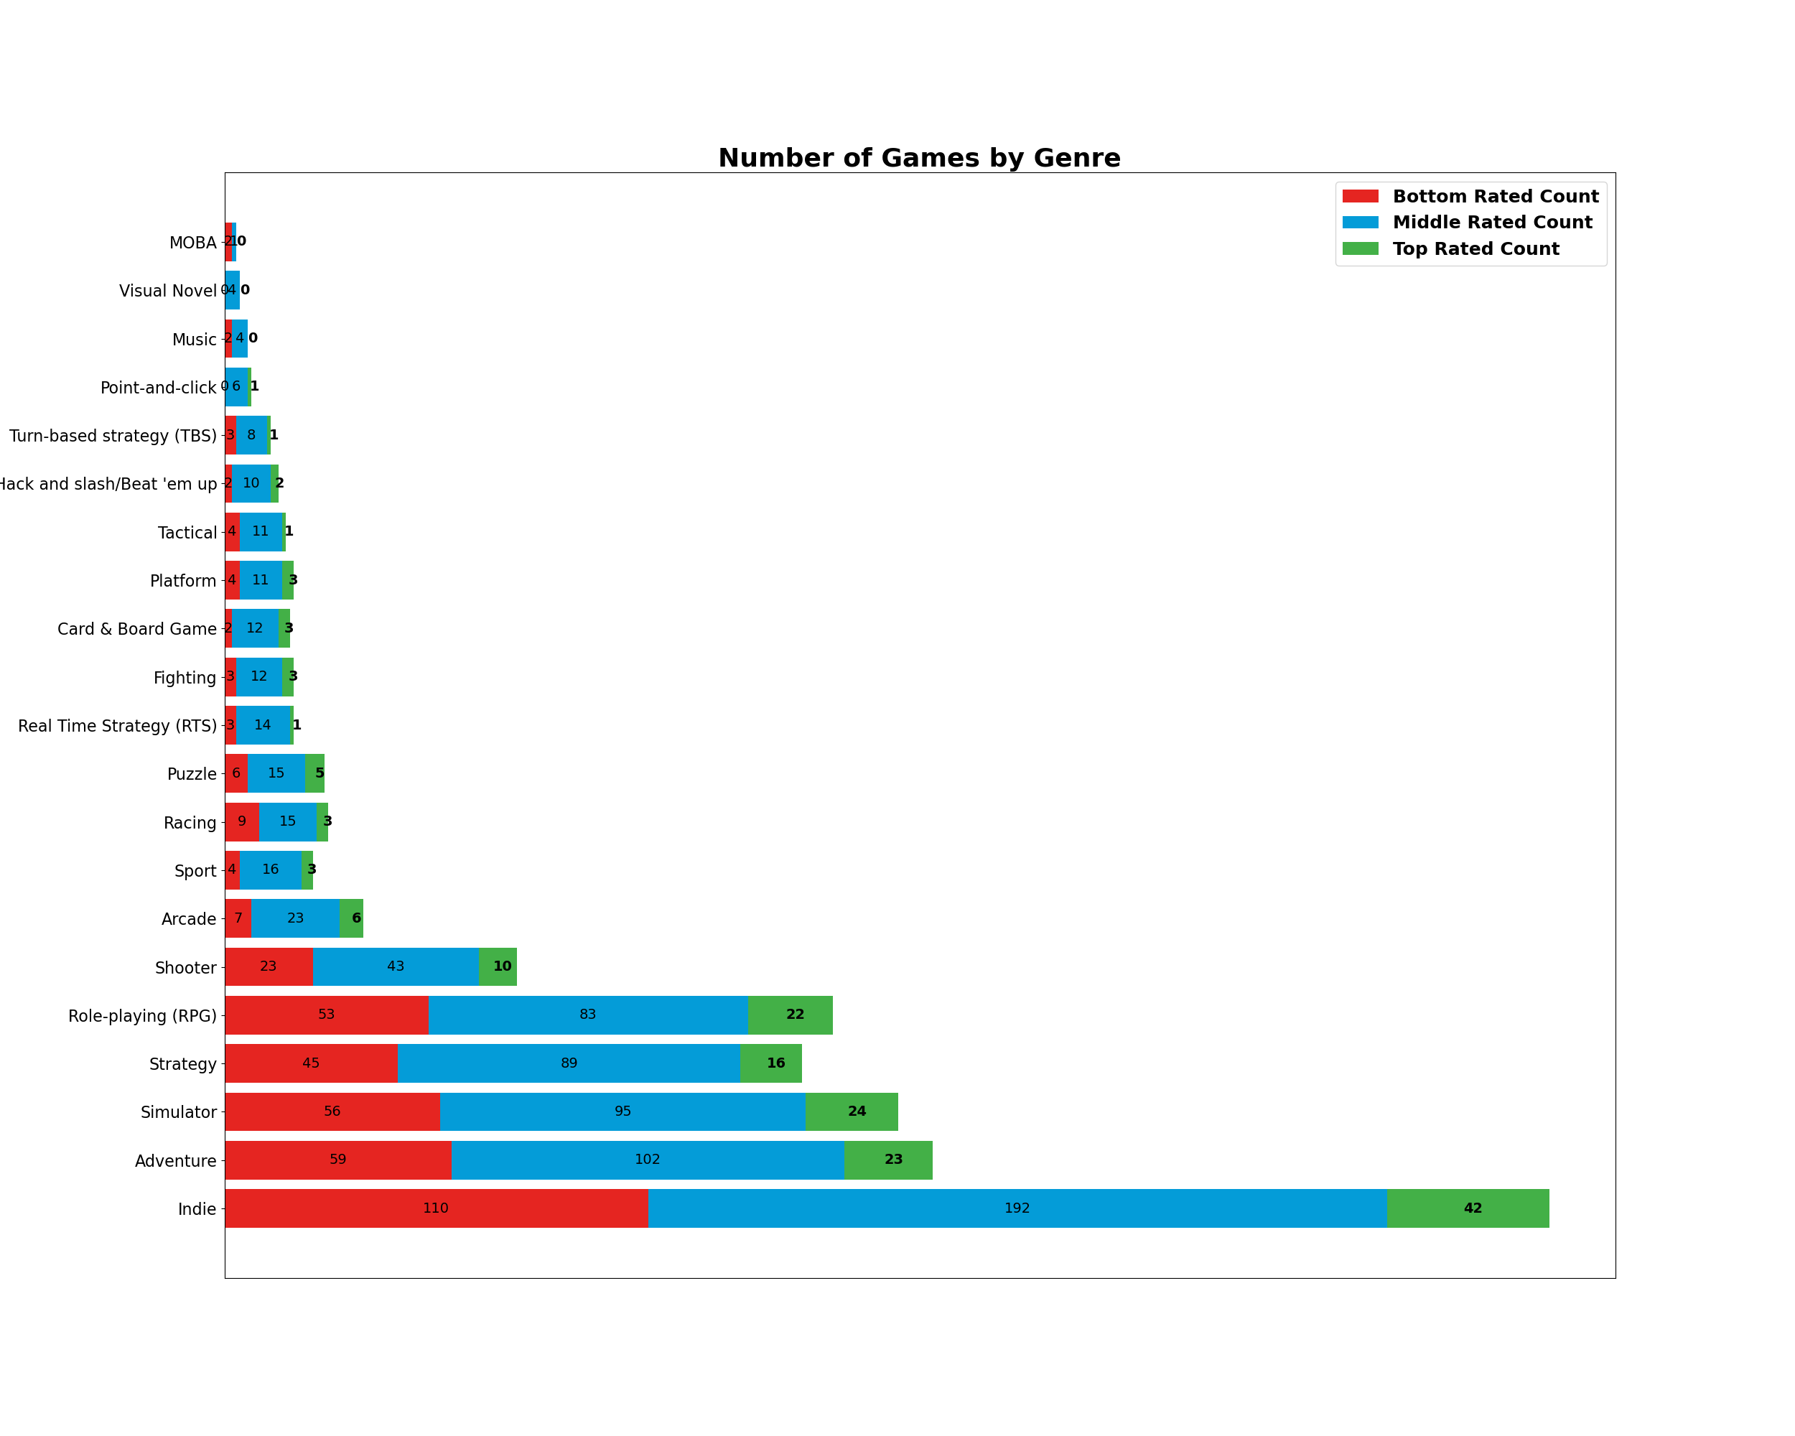
Popularity of Games by Genres:
This chart visualizes the distribution of games across genres and their respective ratings.
It reveals that certain genres exhibit a higher concentration of top-rated games, while others have more games in the middle or bottom rating categories.
The most played genres of games:
Indie
The genre of games that are both highly rated and widely played :
Indie
The least played genres of games. :
Moba- (Multiplayer Online Battle Arena)
Video games….

Slide 10
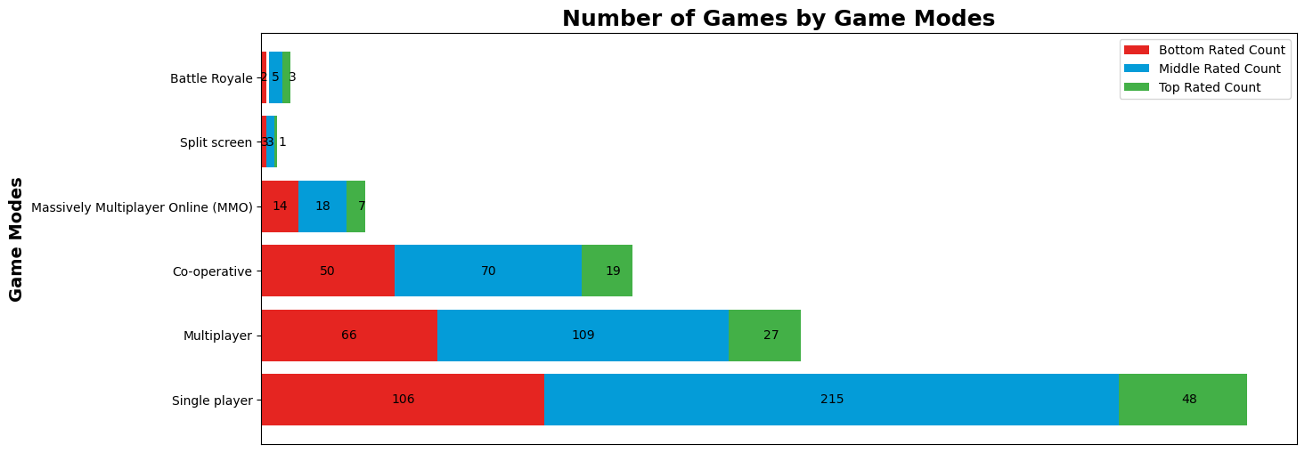
Popularity of Games Based on Game Modes:
The chart visualizes the distribution of games across different game modes categorized by their rating providing insights into which modes tend to receive higher or lower ratings.
Most played game modes: Single Player
Least played game modes :Split Screen
Video games….

Slide 11
Influence of developer experience on game quality :
This plot helps to determine if more experienced developers (those who have developed more games) tend to produce higher or lower-rated games.
Scatter plot and linear regression showing a negligible relationship between the number of games developed and average scores of games
Each point represents a developer, colored by the average score.
The r-value is: -0.009(very weak negative correlation)
The p-value is: 0.852(not statistically significant)
Video games….

Slide 12
Influence of publisher experience on game quality :
This plot examines whether publishers with varying levels of experience, measured by the number of games published, impact the average scores of games they release.
Scatter plot and linear regression showing a negligible relationship between the number of games published and average scores of games
Each point represents a publisher, colored by the average score.
The r-value is: -0.036 (very weak negative correlation)
The p-value is: 0.456 (not statistically significant)
Video games….

Slide 13
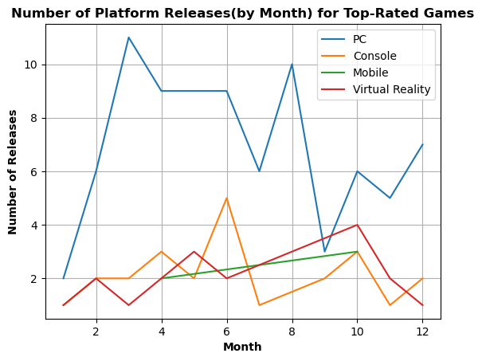
Monthly Release Patterns of Top-Rated Games Across Major Platforms:
This line plot visualizes the number of releases of top-rated games across different major platforms over the months.
This plot reveals,
Seasonal patterns in game releases.
Eg: Spikes in releases are observed during off-peak times or months typically associated with fewer game releases.
The platforms which tend to release more top-rated games
The overall volume of top-rated game releases throughout the year
Video games….

Slide 14
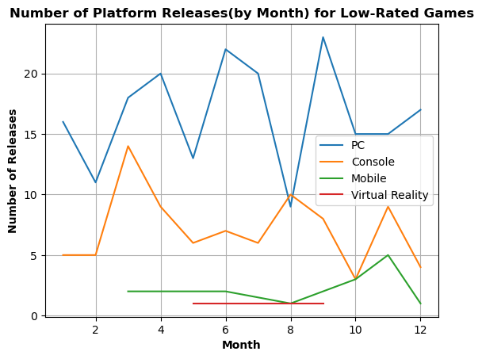
Monthly Release Patterns of Low-Rated Games Across Major Platforms:
This line plot visualizes the number of releases of average and lower-rated games across different major platforms over the months.
This plot reveals,
Seasonal patterns in game releases.- Distributed over the year
The platforms which tend to release more average or lower-rated games in certain months.
The overall volume of top-rated game releases throughout the year
Video games….

Slide 15
Conclusions
North America has a larger and more diverse gaming industry, reinforcing its dominant position in the gaming industry.
Indie games dominate both in terms of play frequency and high ratings, reflecting their widespread appeal and quality.
MOBA games are the least played, possibly due to niche appeal or market saturation.
Single Player modes are overwhelmingly popular and well-rated, indicating strong preference for solo gaming experiences.
Split Screen modes are the least played, possibly due to the rise of online multiplayer options.
The number of games a developer or producer produces does not significantly impact the average quality of their games.
Platform-specific release strategies significantly influence the distribution of top-rated games and other games throughout the year.

Slide 16
Summary
North America is the leading region in terms of both the number of games and the quality of high-rated games.
Indie games are the most popular and highly rated, showing their significant impact on the market.
Single Player modes are preferred over other game modes, reflecting a strong trend towards solo gaming experiences.
Platform-specific release strategies significantly influence the timing and reception of top-rated games versus other games, as illustrated by distinct patterns in their release schedules across major platforms.
The experience of developers and publishers has minimal impact on game quality.

Slide 17



Thank you
?

